Slide 1
PLAN,DESIGN AND ANALYSIS OF SCHOOL BUILDING
GUIDE : MR.S.THANGAPERUMAL
SUBMITTED BY
Naveen C

Slide 2
OBJECTIVE
1) To make a complete design of the main structural elements of a School building including slabs, beams and columns using STAADPro software. Then these general arrangements should ensure a robust and stable structure which would not collapse under the effects of accidental damage to any of these elements.
2) To provide an economical design of a school is to be constructed in a rural area.
3) To learn the basics in designing of a structure which is a mandatory as a civil engineer.

Slide 3
METHODOLOGY
SELECTION OF BUILDING
FIXING DIMENSIONS
DESIGN OF SLABS, BEAMS AND COLUMNS
ANALYSIS BY STAADPRO
MANUAL CALCULATIONS

Slide 4
WORKDONE
SELECTION OF AREA
PLANNING OF BUILDING
ANALYSIS OF BEAMS,COLUMNS AND SLABS
APPLICATION OF LOADS
DESIGN AND CALCULATIONS OF A BUILDING
REINFORCEMENT DETAILING
DEFLECTION OF STRUCTURE

Slide 5
WORK DONE
SELECTION OF MATERIALS
SHEAR BENDING
DIMENSIONING OF BUILDING
DESIGN OF STAIRCASE
STRESS DISTRIBUTION DIAGRAM OF THE STRUCTURE
CRITICAL DEFLECTION OF THE STRUCTURE

Slide 6
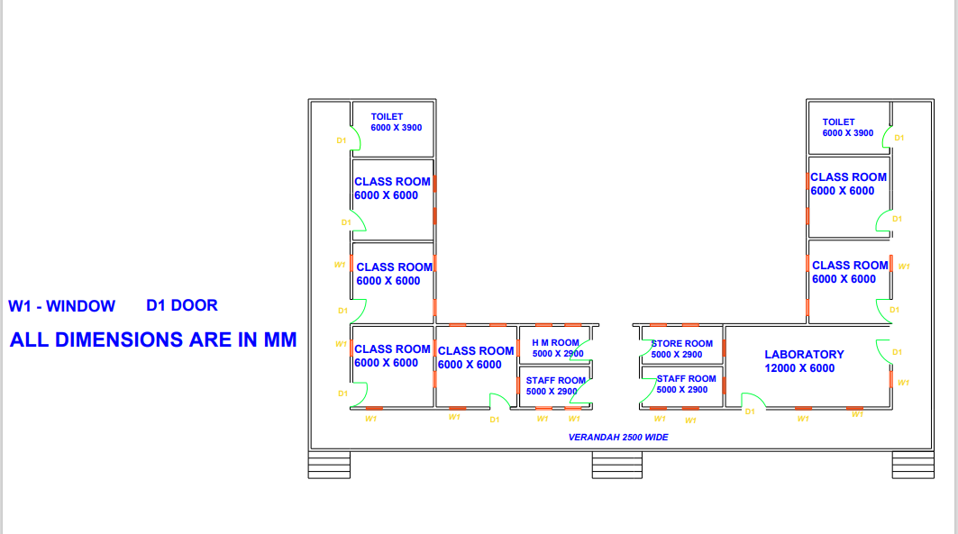
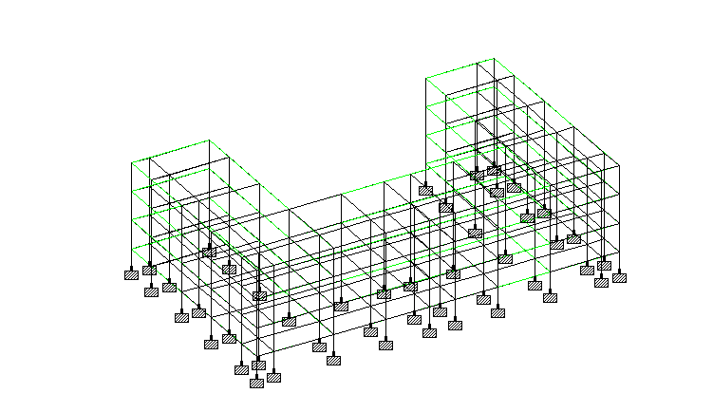
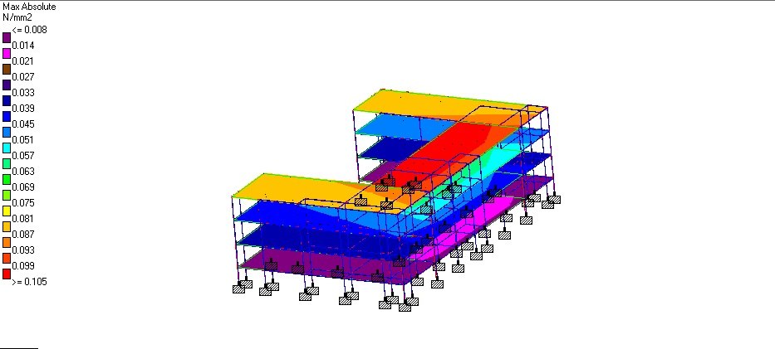
RESULTS AND DISCUSSION

Slide 7
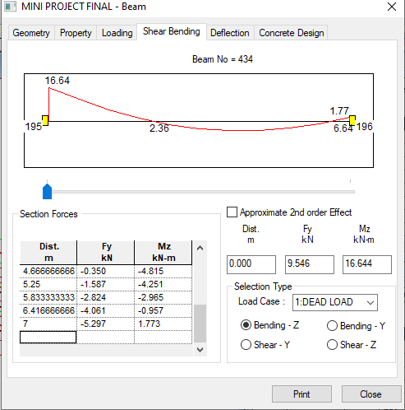
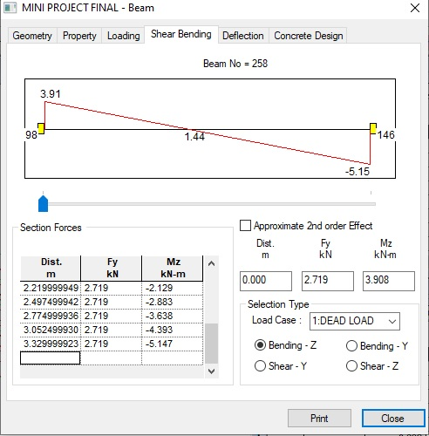
SHEAR BENDING

Slide 8
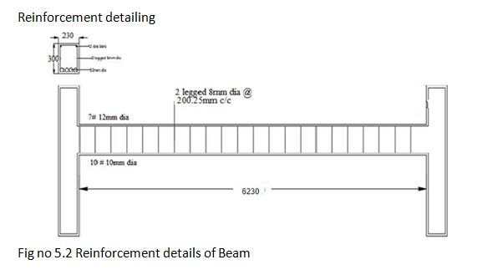
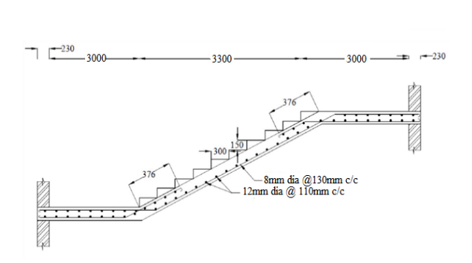
REINFORCEMENT DETAILING

Slide 9
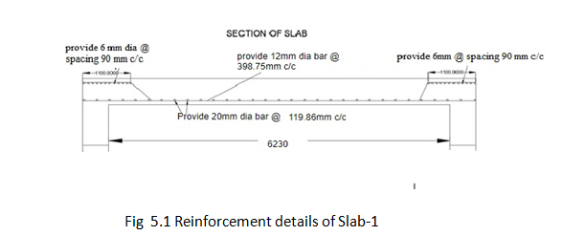
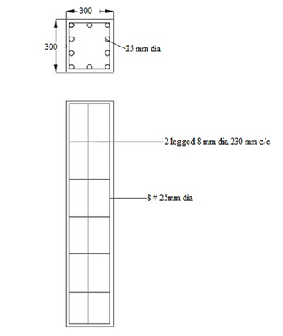
REINFORCEMENT DETAILING

Slide 10
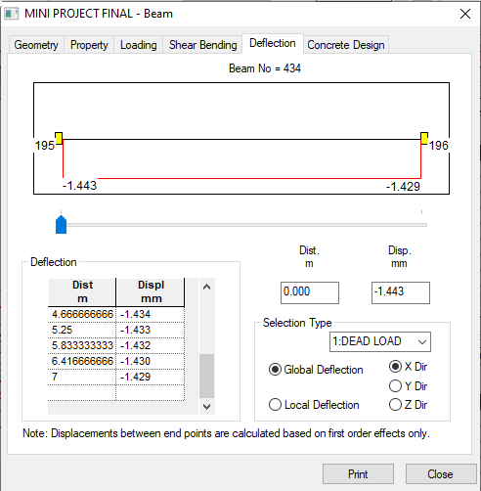
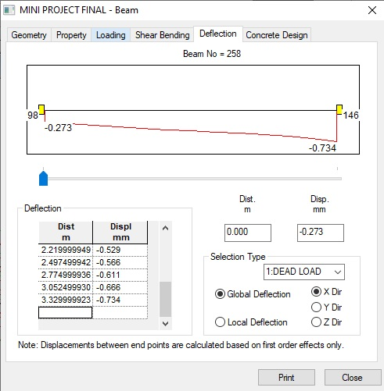
DEFLECTION

Slide 11
CONCLUSION
We conclude that there is difference between the theoretical and practical work done. As the scope of understanding will be much more when practical work is done. As we get more knowledge in such a situation, where we have great experience doing the practical work.
The school building was planned to accommodate to contain all facilities required by following IS Standards. The analysis of frame results was obtained by using software StaadPro. Thus, we get the knowledge about planning, analyzing and designing the structure and this will be helpful for us to enter the design field in the future.

Slide 12
REFERENCE
Krishna Raju, N.,” Design of Reinforced Concrete Structures”, CBS Publishers & Distributors, New Delhi, 2003.
Ramamrutham, S.,” Design of Reinforced Concrete Structures”,
Dhanpat Rai Publishing Company, New Delhi, 2010
Varghese, P.C., “Limit State Design of Reinforced Concrete”,
Prentice Hall of India, Pvt Ltd., New Delhi, 2002
IS 456 – 2000 – Code of practice for design and construction of reinforced concrete structures
SP 16 – 1980 – Design Aids for Reinforced Concrete to IS 456 – 2000
SP 7 – National building code of India
IS 8827 – 1978 - Reference for basic requirements of school building

Slide 13
PPT File have attached

